Slide 1
Capstone Data And sales Analysis report: 2023-2024

Slide 2
Average Purchase Amount and Discount Utilization:
The average purchase amount across all customers and purchases is $59.79.
This indicates a moderate spending behavior among the customers, suggesting that the products are priced in an affordable range for most customers.
By examining the percentage of purchases where discounts were applied, businesses can assess the impact of discount strategies.
Frequent use of discounts might indicate price sensitivity among customers.

Slide 3
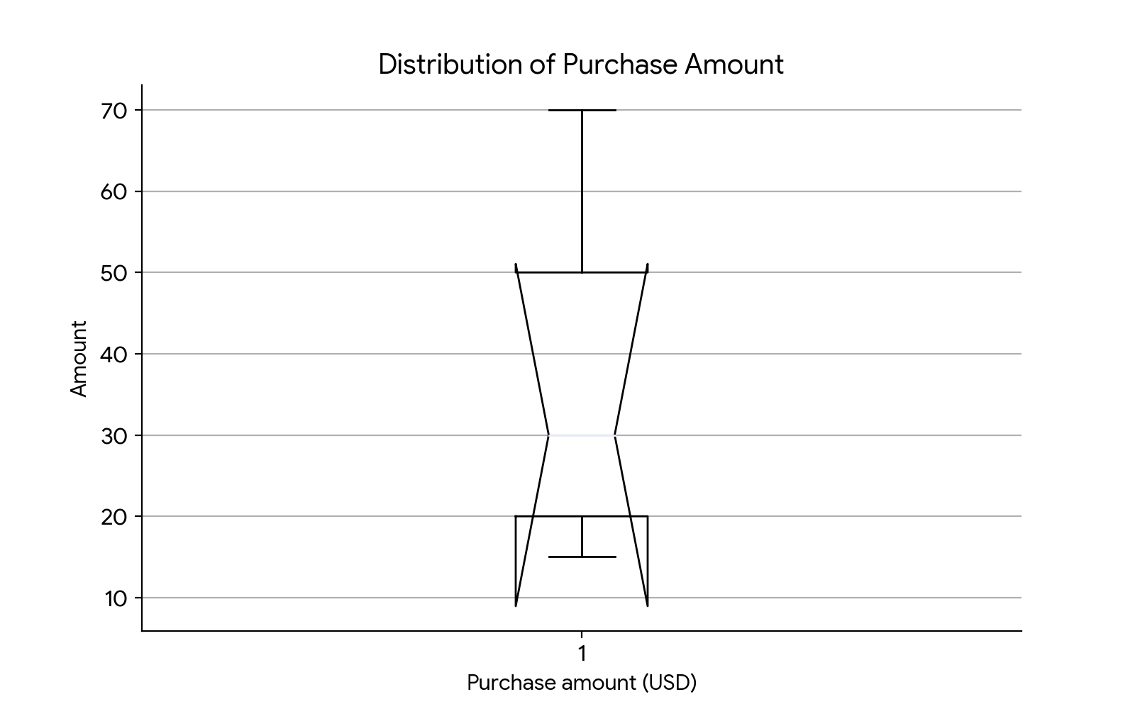
Box Plot:

Slide 4
Seasonal and Shipping Preferences:
In the Spring season, the most popular color for purchased items is Pink.
This could reflect seasonal fashion trends or a preference for brighter colors during this period.
35 customers opted for the Next Day Air delivery option.
This indicates a significant portion of customers value fast delivery, possibly due to urgent needs or preference for quick gratification.

Slide 5
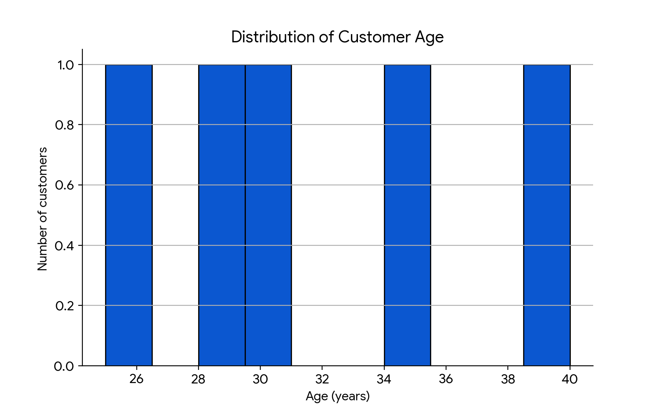
Histogram:

Slide 6
Purchase Frequency and Payment Methods:
38 customers make purchases on a weekly basis.
This high frequency suggests a group of highly engaged customers who may benefit from targeted loyalty programs or subscription models.
Customers use a variety of payment methods, with preferences for Credit Card, PayPal, and Cash.
Understanding these preferences helps in optimizing the checkout process and ensuring that preferred payment methods are prominently featured.

Slide 7
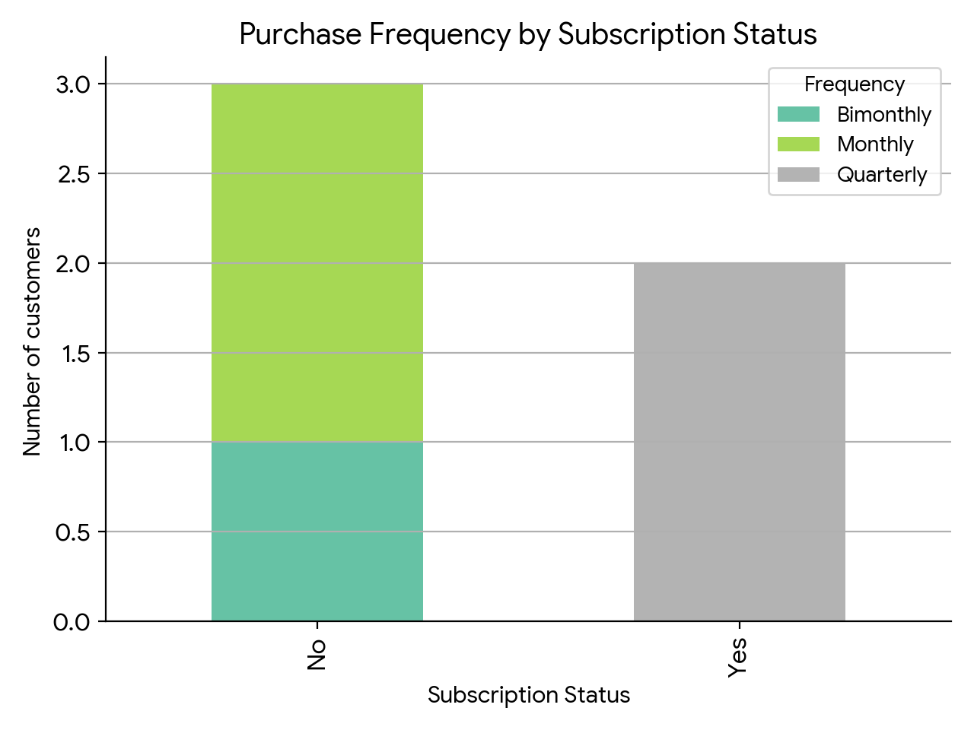
Bar GrapH:

Slide 8
Gender Distribution and Subscription Status:
By examining the gender distribution, businesses can better understand if there is a gender skew and tailor marketing efforts accordingly.
For example, if a significant majority of purchasers are women, targeted marketing campaigns can be designed to appeal to female customers.
Analyzing the subscription status can reveal the effectiveness of subscription models and customer retention strategies.
Customers who are subscribed may have different purchasing behaviors compared to non-subscribed customers.

Slide 9
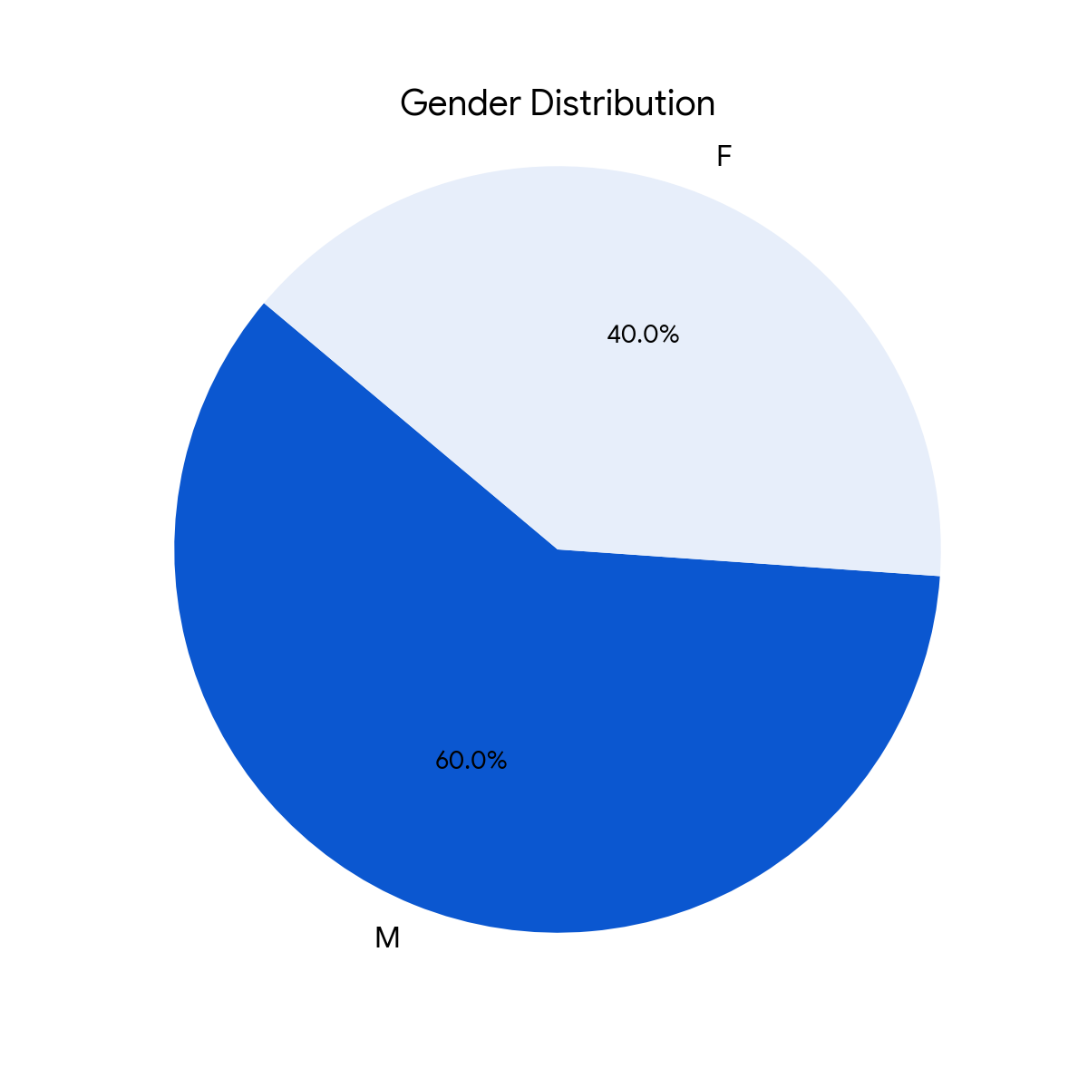
PiE Chart:

Slide 10
Review Ratings and Geographic Distribution:
The average review rating given by customers can provide insights into overall customer satisfaction.
High ratings suggest good product quality and customer service, while lower ratings might indicate areas for improvement.
Understanding the geographic distribution of customers helps in planning logistics, regional marketing campaigns, and inventory management.
Identifying regions with high customer concentration can also help in deciding locations for new stores or warehouses.

Slide 11
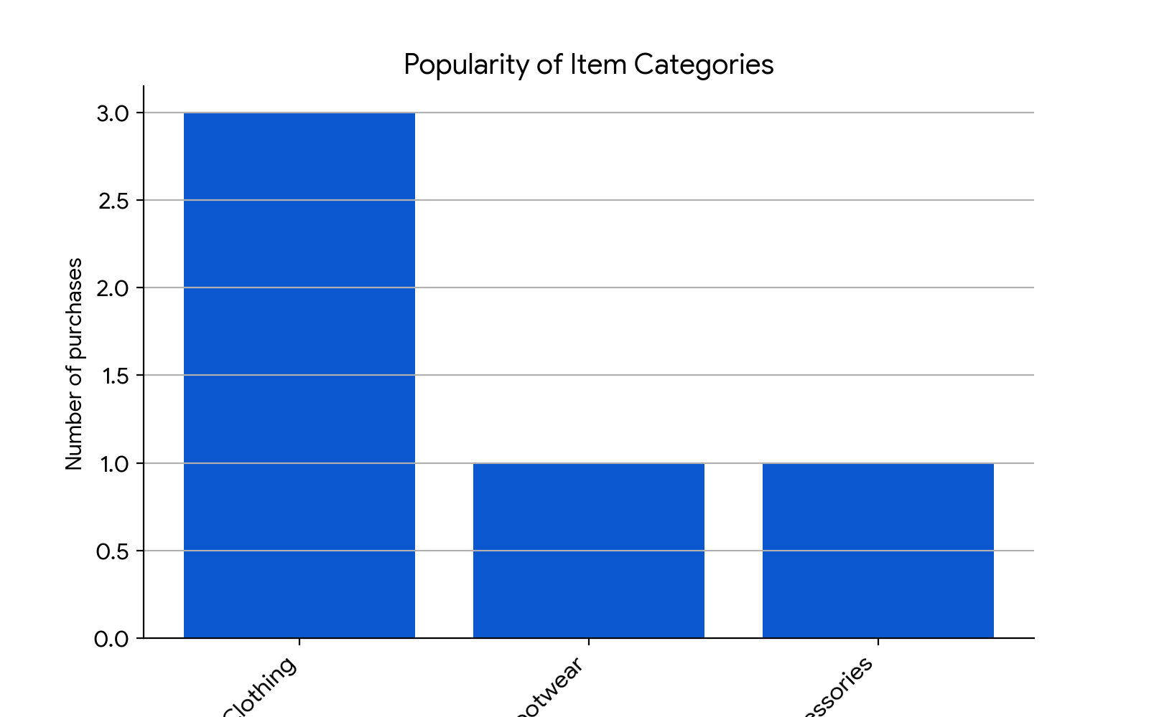
BAR GRAPH:

Slide 12
Pitch Presentation
1. Average Purchase Amount
Average Spend: Customers spend an average of $59.79 per purchase.
Actionable Insight: Our pricing aligns well with customer expectations, making our products accessible.
2. Seasonal Preferences
Spring Trend: Pink is the dominant color during spring.
Actionable Insight: Leverage this trend in seasonal marketing campaigns and product displays.
3. Shipping Preferences
Fast Delivery: 35 customers prefer Next Day Air.
Actionable Insight: Highlight expedited shipping options prominently to cater to urgent needs.

Slide 13
Pitch Presentation
4. Purchase Frequency
Engaged Customers: 38 customers shop weekly.
Actionable Insight: Launch loyalty programs or subscriptions for this active segment.
5. Gender Distribution
Gender Skew: Assess if most purchasers are women.
Actionable Insight: Tailor marketing efforts to appeal to the dominant gender.
6. Payment Methods
Preferred Methods: Credit Card, PayPal, and Cash.
Actionable Insight: Optimize checkout process for these popular payment options.

Slide 14
Pitch Presentation:
7. Subscription Status
Retention Strategy: Analyze subscribed vs. non-subscribed behaviors.
Actionable Insight: Enhance subscription benefits to retain customers.
8. Discount Utilization
Price Sensitivity: Frequent discount usage.
Actionable Insight: Strategically offer discounts to drive sales.
9. Review Ratings
Customer Satisfaction: High ratings indicate quality.
Actionable Insight: Maintain excellent product quality and service.
10. Geographic Distribution
Regional Focus: Identify high-concentration areas.
Actionable Insight: Expand stores or warehouses strategically

Slide 15
Actionable recommendations:
1.Segmented Marketing:
Targeted Campaigns: Leverage the gender distribution data to create gender-specific marketing campaigns. Tailor product recommendations and promotions accordingly.
Seasonal Promotions: Capitalize on the seasonal color trend (pink during spring) by offering limited-time collections or discounts on pink items.
2.Shipping Optimization:
Fast Delivery Promotion: Highlight Next Day Air as a premium shipping option during checkout. Consider offering incentives for customers who choose this service.
3.Customer Retention:
Subscription Enhancements: Evaluate the subscription model. Can you offer additional perks or exclusive content to subscribers? Enhance the value proposition to retain these customers.

Slide 16
Actionable recommendations:
4.Pricing Strategy:
Discount Timing: Strategically time discounts to align with high purchase frequency periods (e.g., weekly shoppers). Use personalized discount codes to encourage repeat purchases.
5.Geographic Expansion:
High-Concentration Areas: Investigate regions with the highest customer concentration. Consider opening new stores or distribution centers in those locations.
6.Review Management:
Quality Assurance: Maintain excellent product quality and customer service to ensure positive reviews. Address any negative feedback promptly.

Slide 17
Data Analysis:
1) Sales by Season:
Fall was identified as the season with the highest total sales.
It's important to analyze trends over multiple years to confirm Fall's consistency as the peak season.
2) Sales by Location:
Virginia was the location with the most sales.
Further analysis can identify specific store performance within Virginia.
3) Sales by Category:
Clothing was the category with the maximum revenue generated.
Examining sub-categories within clothing (e.g., outerwear vs. casual wear) can reveal more granular insights.

Slide 18
Further Analysis:
Fall is the current peak sales season.
Virginia is the top-performing location in terms of sales.
Clothing is the leading sales category.
Investigate trends over multiple years to confirm sales seasonality.
Analyze sales performance of individual stores within Virginia.
Segment customer data to understand demographics of high-spending customers in Virginia during Fall.
Analyze sales trends for sub-categories within the Clothing category.

Slide 19
Recommendations:
Inventory Management:
Based on the Fall peak season, optimize inventory planning to ensure adequate stock of popular clothing items during that period.
Marketing Campaigns:
Target marketing efforts towards Virginia throughout the year, with a specific focus during Fall. Analyze customer demographics in Virginia to tailor campaigns further.
Product Development & Promotions:
Analyze what type of clothing sells best in Fall within Virginia. Consider product development or promotions focused on those specific clothing sub-categories.

Slide 20
Hiring Recommendations:
Hiring Strategy: While Fall is the peak sales season, it might not be the optimal time for hiring new sales staff. Hiring during your busiest season can strain existing resources and limit proper training for new hires. Ideally, you want your new salespeople to be contributing during peak times. Here are some alternative times to consider for sales hiring:
Early Fall (Pre-Season): This allows for onboarding and training before the peak season rush. New hires can shadow experienced salespeople and learn the ropes before taking on a full workload.
January (Post-Holiday): Many companies re-evaluate their budgets and staffing needs after the holiday season. Hiring in January allows you to take advantage of the new year's fresh start and potentially find strong candidates looking for new opportunities.
Company Fiscal Year End: Similar to January, some companies might have hiring budgets tied to their fiscal year-end (often March or April). Hiring around this time allows for strategic planning and aligning new hires with upcoming goals
Since,California,Virginia,New York was the location with the most sales,we need maximum workforce to be hired there.

Slide 21
THANK YOU

